Slide 1
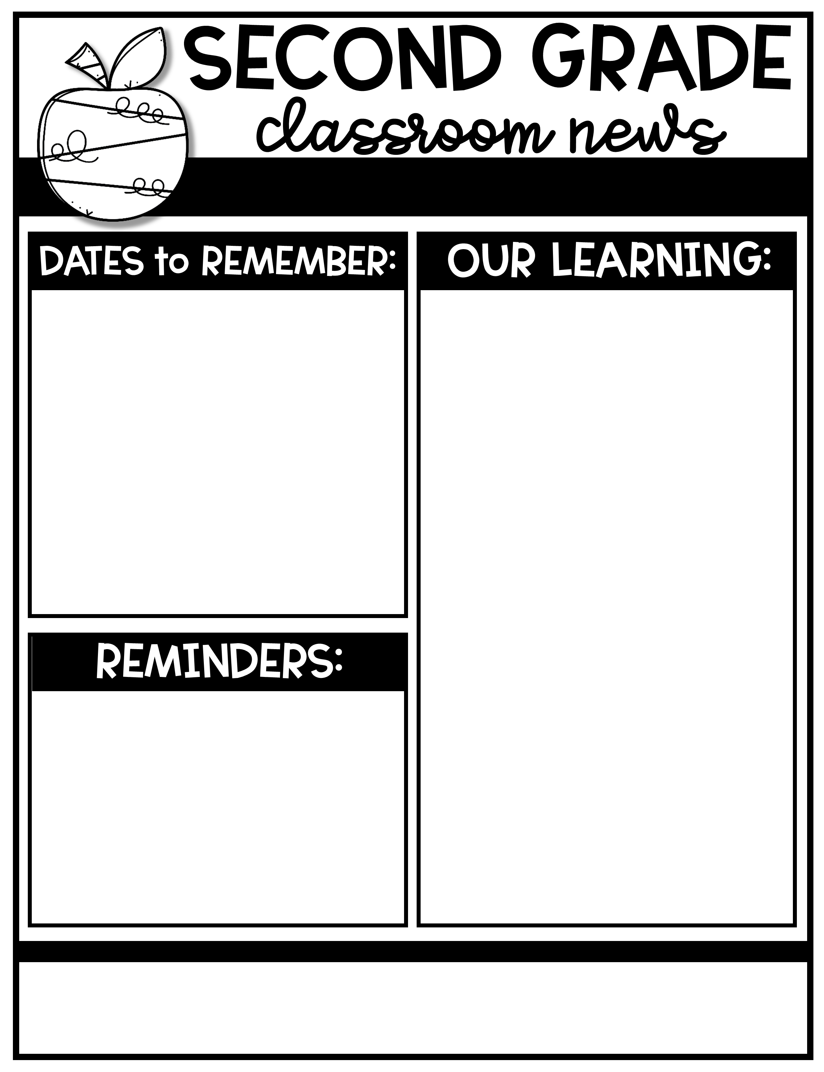
Ms. Tompkins’ Newsletter August 22-26, 2022
August 22nd-26th | STAR Testing
August 26th | PBIS Kickoff
September 5th | LABOR DAY!-NO SCHOOL! ☺
September 13th | PTO Meeting
Skills for the week 3: Reading- Ask and answer questions: who what where when how and why. Main topic and key details Language- simple sentences-capitalization and punctuation Phonics- Magic e blends words and words with –es /z/ Writing- Narrative Baseline Math- adding and subtracting within 10 Social Studies- Citizenship/community
Week 3
Word Wall Words- Silent e (long vowel)
stove
snake
trade
flute
broke
close
pride
stripe
grape
Spoke
RED WORD- said
Please send back all forms ASAP!
Pay on “MySchoolBucks” on Madison county website
PTO Fee $10
Supply Fee $40
Chrome Book Fee $25
Your child can bring a sweater to class. Our Classroom sometimes gets cool!
Wear tennis shoes on PE day (Tuesday)
Sign your child’s BLUE Take Home Folder every day.
Make sure to send a pair of headphones/earphones.
Ann Smith Elementary
601-856-6621
atompkins@Madison-schools.com
Theme: “You‘ve got a friend in ME!”
Character Trait: RESPONSIBILITY

